Slide 1
K
KnowledgeIQ
PROJECT & TECHNICAL DOCUMENTATION
KnowledgeIQ
Enterprise Workforce Skill Intelligence & Adaptive Learning Platform — mapping organizational competencies, detecting critical skill gaps, and generating personalized learning interventions.
Java 17 · Spring Boot 3.2
React 18 + Vite
PostgreSQL · Supabase
Google Gemini AI
Team 8 · Springboard Mentorship Program
2026

Slide 2




01 — ARCHITECTURE
Technology Stack
Frontend
Backend
Data & AI
DevOps & Tooling
React 18 SPA
Vite 5 build tooling
Tailwind CSS + Recharts
Lucide icon system
Java 17 · Spring Boot 3.2.3
Spring Security 6 + JWT
Spring Data JPA / Hibernate
HikariCP connection pool
PostgreSQL (Supabase Cloud)
27 relational JPA entities
Google Gemini AI advisor
Offline heuristic fallback
Docker + Docker Compose
Maven (mvnw) build
Node.js QA automation
Nginx production serving
92 Java source files · 19 REST controllers · 15 service modules · 24 Spring Data repositories

Slide 3




02 — CAPABILITIES
Core Features of the Platform
Dynamic Competency Mapping
Automated Gap Engine
Evaluates proficiency (Levels 1–5) against role benchmarks, with radar-chart comparisons and self, peer & manager assessments.
Computes deficit = max(0, Required − Current), scores severity (Critical/High/Medium/Low) and tracks historical gap snapshots.
Adaptive Learning Paths
Peer Knowledge Exchange
Sequences courses by prerequisite weight and gap urgency, tracked across four milestones, auto-elevating proficiency on completion.
Expert host eligibility (≥90% proficiency), live knowledge sessions, 1-on-1 mentorship matching, and structured feedback loops.
Delivered across 6 role-based dashboards: Employee · Manager · HR Specialist · Department Head · L&D Admin · System Admin

Slide 4
03 — PROBLEM CONTEXT
Challenges Facing the Industry
01
Static Skill Profiles
Traditional HR records skills once at hiring; real capability decays or evolves completely unmonitored afterward.
02
Invisible Competency Deficits
Organizations lack real-time visibility into high-risk capability gaps before launching strategic projects.
03
Fragmented Learning Journeys
Training catalogs stay disconnected from detected skill benchmarks, driving low completion and poor ROI.
04
Siloed Domain Knowledge
Senior subject-matter experts lack structured peer platforms to host sessions and mentor junior talent.

Slide 5

04 — SYSTEM DESIGN
System Architecture Overview
React 18 + Vite Frontend
6 role-based dashboards · Recharts visualizations · Tailwind CSS
REST API — Stateless JWT Bearer Authentication
Spring Boot 3 REST Backend
19 controllers · 15 services · Spring Security 6 · Gap Analysis & Gemini AI engines
Spring Data JPA / Hibernate — JDBC
PostgreSQL Database (Supabase Cloud)
27 relational entities — users, skills, benchmarks, courses, mentorships, sessions
Security: BCrypt password hashing (strength 10) · @PreAuthorize endpoint isolation · CORS restricted in production

Slide 6
05 — ENGINEERING DECISIONS
Challenges & Solutions in KnowledgeIQ
Challenge | Engineering Solution
Skill records go stale after hiring | Continuous self / peer / manager assessments auto-recalculate gaps via GapAnalysisService
No visibility into high-risk shortages | Automated Gap Engine with Critical / High / Medium / Low severity scoring and historical snapshots
Training catalogs disconnected from real gaps | Adaptive learning paths sequenced by prerequisite weight and gap urgency (Critical → Low)
Unverified peer knowledge-sharing hosts | Host eligibility engine enforcing ≥90% (Level 4+) proficiency before a session can be created
Manual, inconsistent reporting across roles | Role-scoped dashboards plus one-click PDF / CSV export for HR, managers & department heads

Slide 7
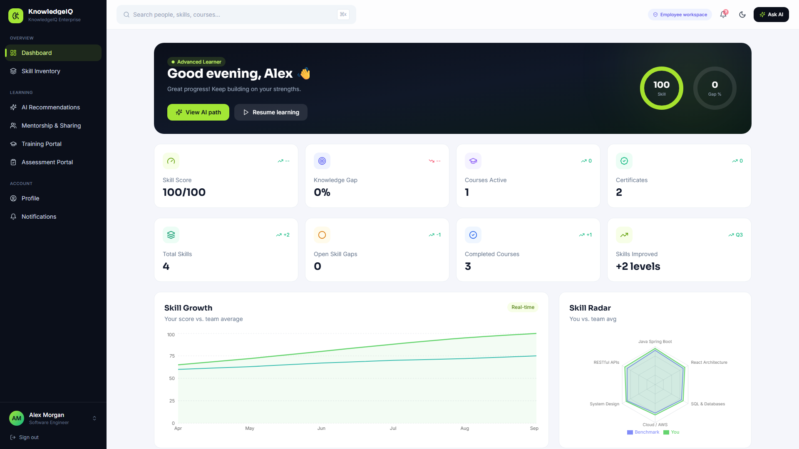
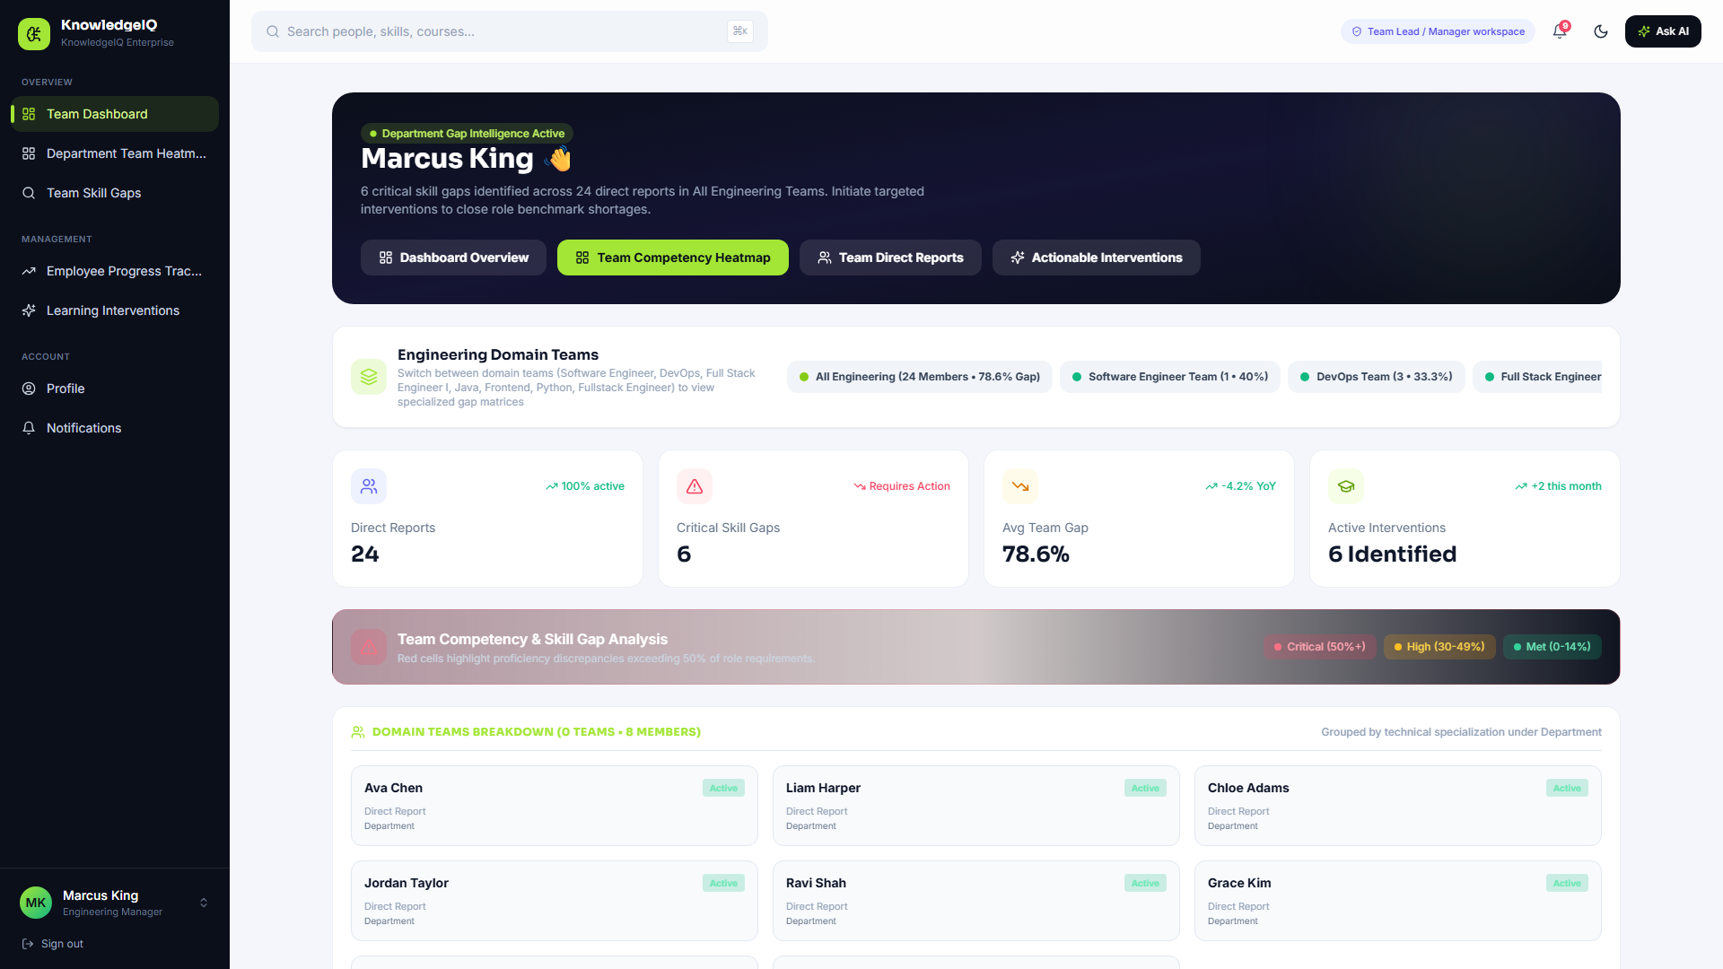
06 — PRODUCT WALKTHROUGH · 1 OF 3
Screenshots — Employee & Manager Views
Employee Dashboard
Manager — Team Gap Heatmap
Skill score, growth trend, and a radar of personal proficiency vs. team average.
Domain team grouping with a critical / high / met skill-gap matrix per direct report.

Slide 8
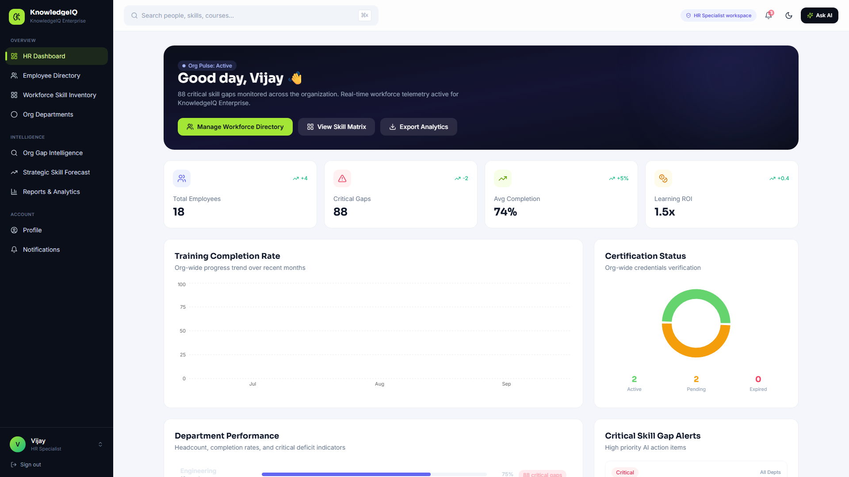
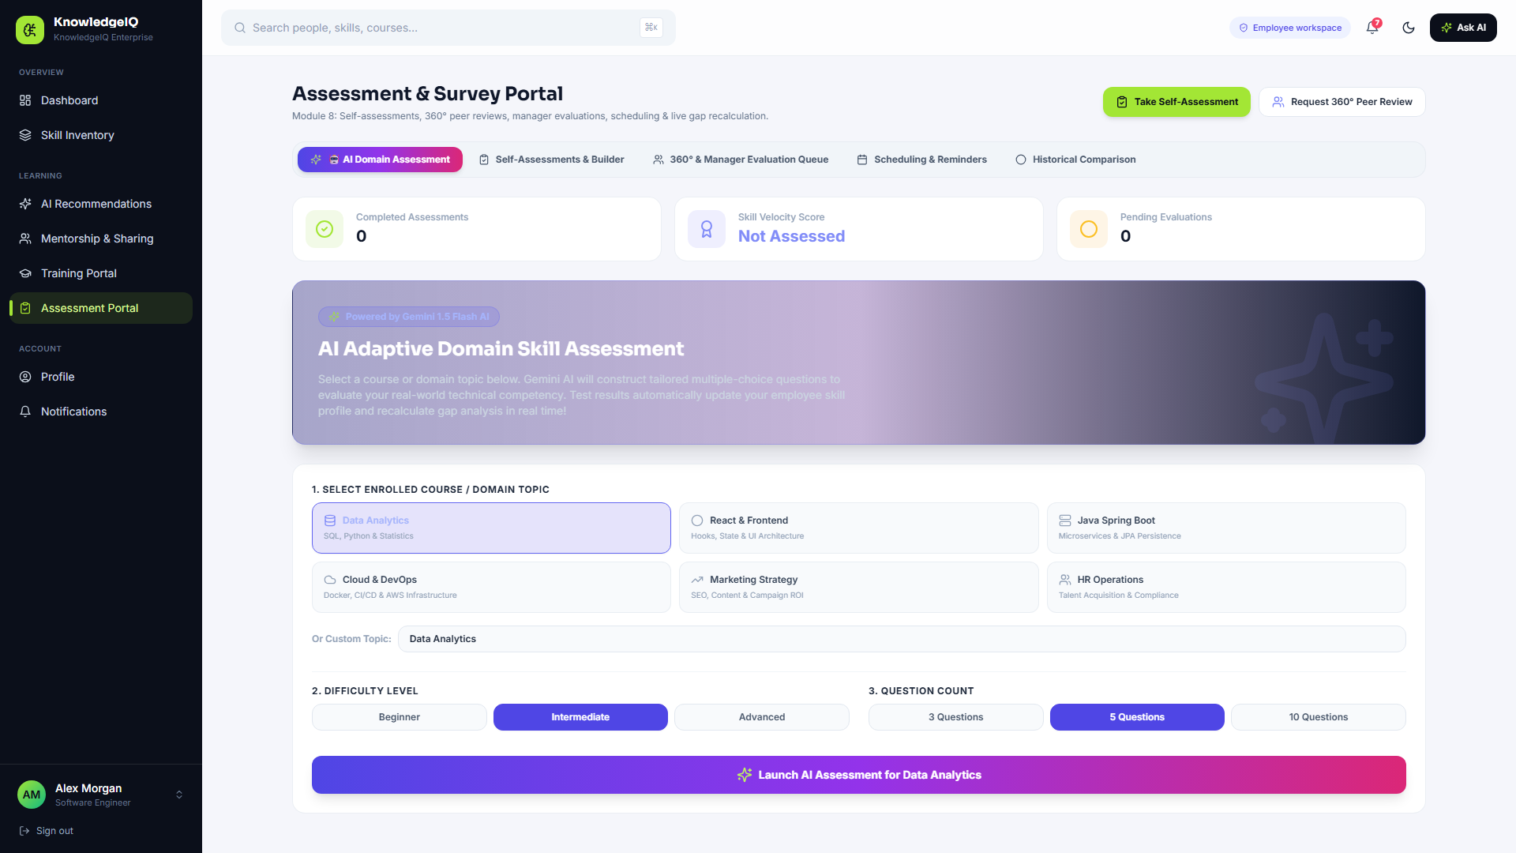
06 — PRODUCT WALKTHROUGH · 2 OF 3
Screenshots — HR & AI Assessments
HR Analytics Dashboard
AI Adaptive Assessment Portal
Org-wide critical gaps, training completion trend, and certification status at a glance.
Gemini-generated skill tests that update the employee's proficiency profile in real time.

Slide 9
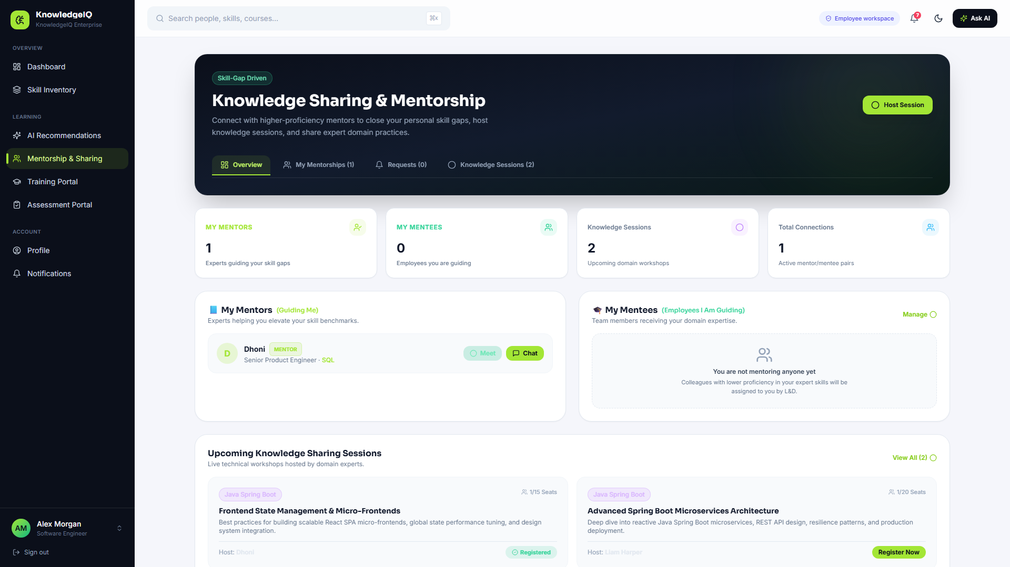
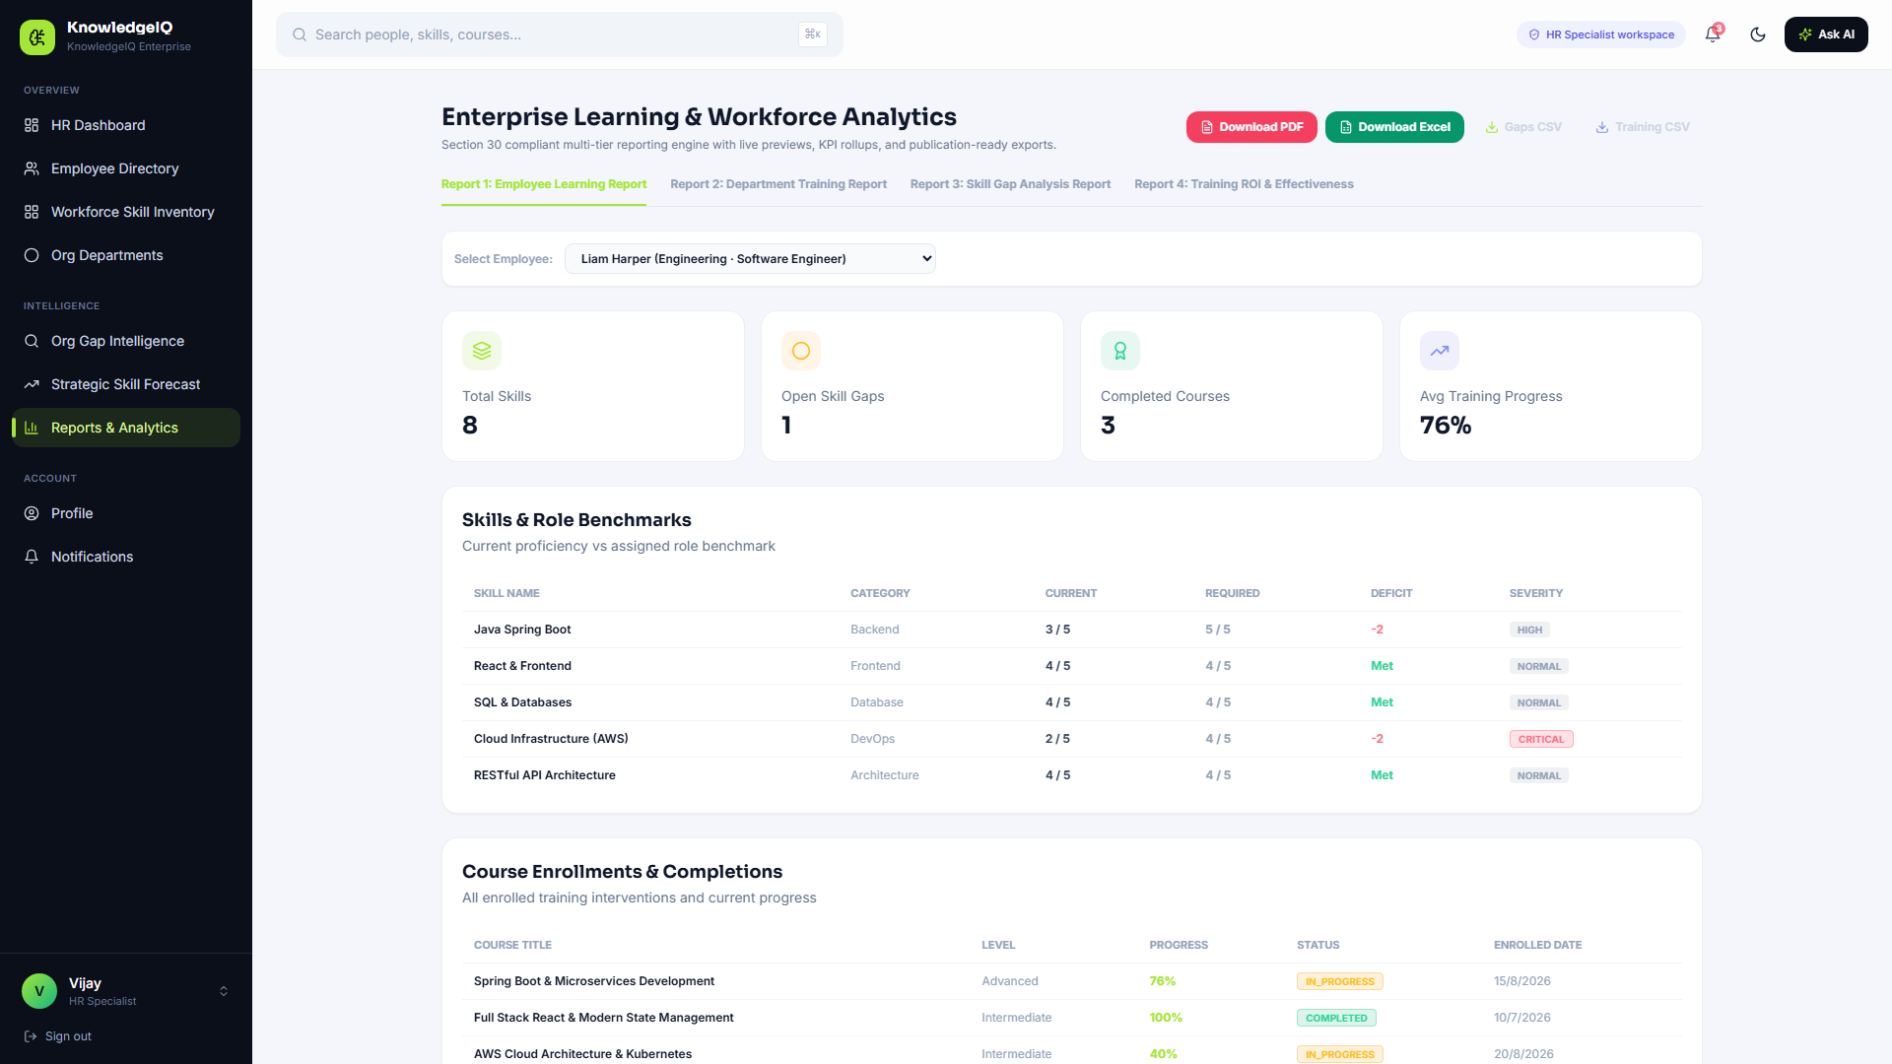
06 — PRODUCT WALKTHROUGH · 3 OF 3
Screenshots — Mentorship & Reporting
Peer Mentorship & Sessions
Reports & Analytics Export
Mentor / mentee matching plus live knowledge-sharing session scheduling.
One-click PDF / Excel / CSV exports across four report types, per Section 30 compliance.

Slide 10
07 — IMPACT
Measurable Outcomes & Positive Impact
1,284
96%
3.4x
Employees mapped in the demo workspace
Organization-wide skill coverage
Learning ROI multiplier
6
19 / 27
100%
Role-based dashboards shipped
REST controllers / JPA entities built
Milestone 3 core workflows verified end-to-end
Figures reflect the KnowledgeIQ Enterprise demo workspace and the Milestone 3 integration audit

Slide 11
08 — ROADMAP
Future Enhancements
PHASE 1 · Q1–Q2
PHASE 2 · Q3–Q4
PHASE 3 · HORIZON
Knowledge & RAG
Credentials & Live Streaming
Predictive ML & Enterprise Scale
pgvector corporate policy embeddings
WebSocket peer mentorship chat
Floating RAG semantic document assistant
OpenBadges 3.0 verifiable certificates
WebRTC in-browser live session streaming
Collaborative virtual whiteboard canvas
Predictive skill-deficit & succession ML
Schema-per-tenant multi-tenancy
SAML 2.0 / Okta SSO & SCIM sync

Slide 12
09 — THE TEAM
Team Members
Team 8 · Springboard Mentorship Program
NV
NI
MA
YP
Nidarshan V
Nakul Pradip Indurkar
Mohammad Arshad
Yadav P
Nidarshan

Slide 13
OPEN FLOOR
Questions?
Happy to walk through the codebase, architecture decisions, the gap-analysis algorithm, or a live demo.

Slide 14
K
Thank You
KnowledgeIQ — Team 8, Springboard Mentorship Program

